Slide 1
Interrupted Time Series Analysis
Olivia Bryant
olivia.bryant.22@ucl.ac.uk
Monday 19th June

Slide 2
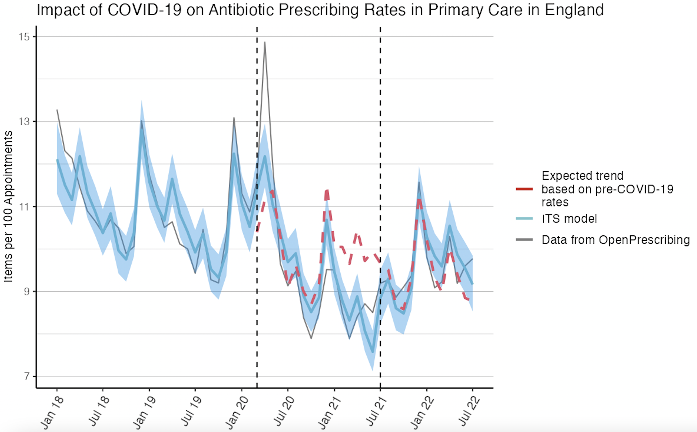
What is an interrupted time series analysis?
Sometimes referred to as segmented regression analysis, interrupted time series analysis is a quasi-experimental method to evaluate the impacts of interventions (e.g. major policy changes).
Compares a model of observed data after the intervention (the “expected trend”) with a “counterfactual”.
Usually applied to population-level data.

Slide 3
Methodological Considerations
A clearly defined intervention point. This does not necessarily have to be one specific date but needs to be a clearly defined period, even if it is implemented across a time period. E.g. ban on smoking, lockdowns.
Time series data with sufficient pre-intervention data to establish the underlying trend.
Post-intervention data should be included only if you are satisfied that impacts can be attributed to the intervention.
The outcome take many forms (typically counts). ITS works best for short-term outcomes with rapid onset following the intervention.

Slide 4
Pros
Cheap and easy to implement.
Can be applied to a range of different types of outcome.
It can be conducted with a relatively small sample size.
It is typically conducted at the population-level.
Can produce clear visuals that are understandable to the lay person.
Cons
No randomization.
Results are dependent on the definition of the intervention.
Not appropriate when trends are not, or cannot be transformed to be, linear.
Can be impacted by issues relating to seasonality, if not appropriately adjusted for.

Slide 5
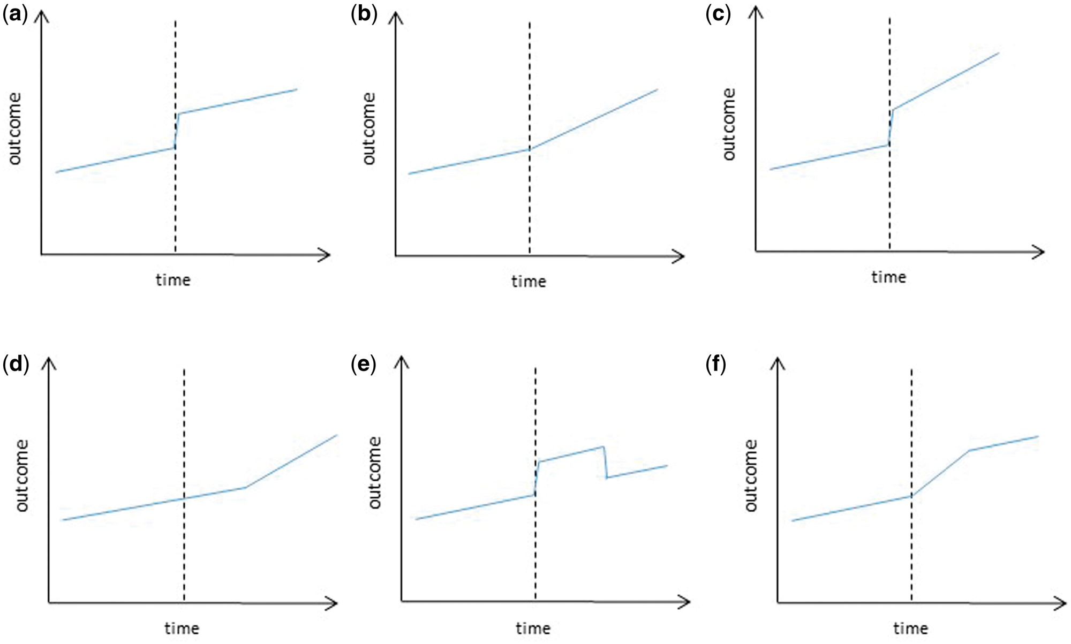
Potential impact models – combinations of step changes and slope changes
Lopez Bernal J, Cummins S, Gasparrini A. Interrupted time series regression for the evaluation of public health interventions: a tutorial. International Journal of Epidemiology. 2016 Jun 9;46(1):dyw098.
‌

Slide 6
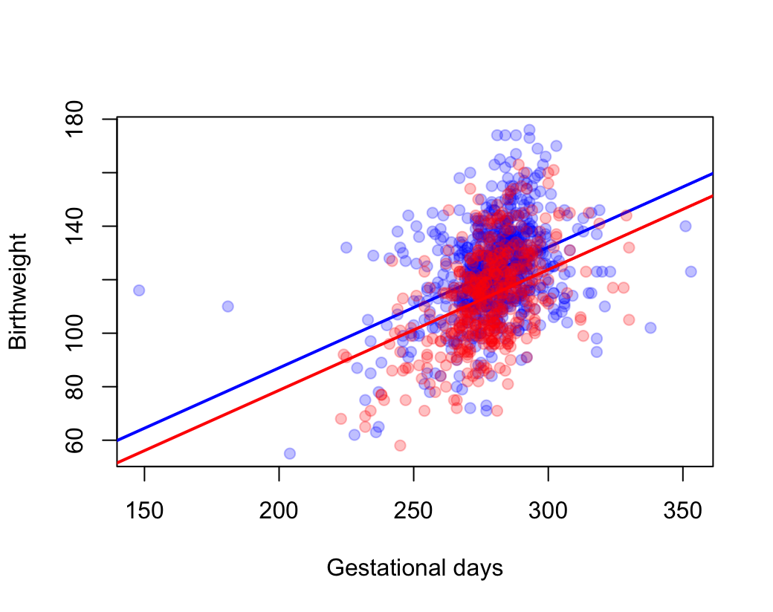
Linear Regression with Binary Variables
No interaction term between a binary variable and a continuous variable.
Birth weight = gestational days + smoking status of mother (binary variable)
Blue = mother does not smoke
Red = mother does smoke
The two lines have a common slope with varying intercepts = change in level

Slide 7
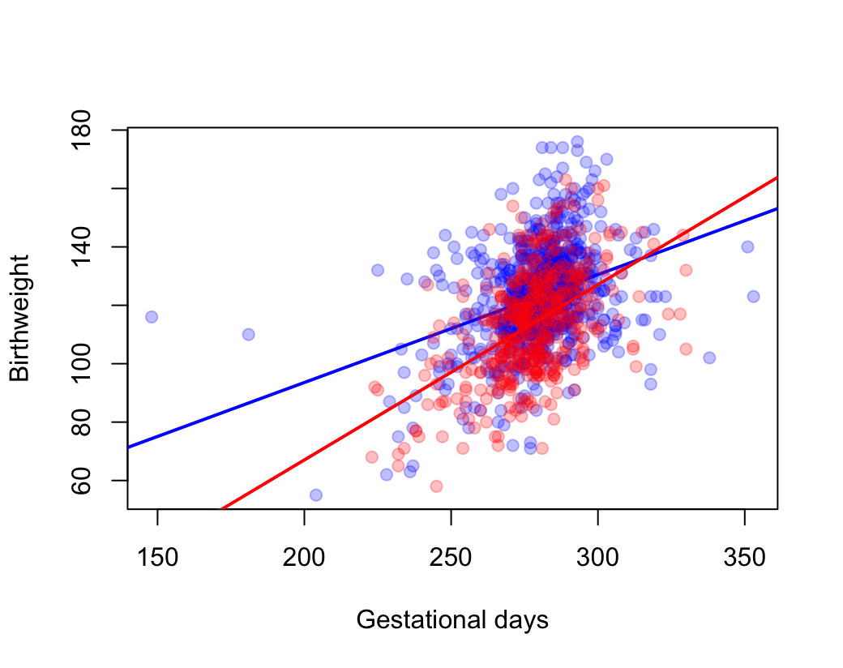
Linear Regression with Binary Variables
Interaction term between a binary variable and a continuous variable.
Birth weight = gestational days + smoking status of mother (binary variable) + interaction between smoking status and gestational days
Blue = mother does not smoke
Red = mother does smoke
The two lines have differing slopes and differing intercepts = change of level and slope

Slide 8
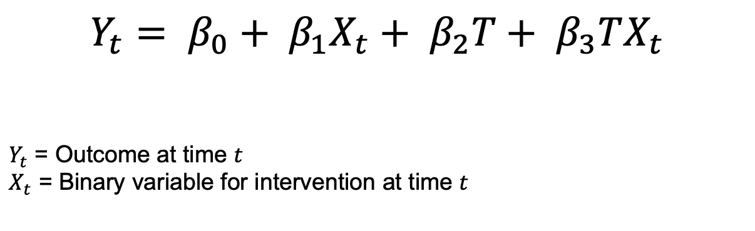
ITS Model for Change in Level and Slope
$$Y_{t}= β_{0}+ β_{1}X_{t}+ β_{2}T+ β_{3}TX_{t}$$
$Y_{t}$ = Outcome at time $t$
$X_{t}$ = Binary variable for intervention at time $t$

Slide 9
ITS Model for Change in Level and Slope
$$Y_{t}= β_{0}+ β_{1}X_{t}+ β_{2}T+ β_{3}TX_{t}$$
$Y_{t}$ = Outcome at time $t$
$X_{t}$ = Binary variable for intervention at time $t$
Given that the interaction will be zero when the intervention is zero, this term relates to the time since the intervention.

Slide 10
Options for Models
Binomial – option if the outcome is between 0 and 1, such as a percentage.
Poisson – used to model counts.
Negative binomial model – also used to model counts but it has an extra parameter compared to the Poisson which allows for the adjustment of the variance independently from the mean. Useful for overdispersed data (where the variance is greater than the mean).

Slide 11
Confounding
For confounders that are not time-varying, these do not need to be included in the model.
For measured time-varying confounders, these can be adjusted by putting them in the regression model.
Changing sample size:
For binomial models, model outcome as a proportion.
For negative binomial and Poisson models, use an offset term for the population size.

Slide 12
Confounding
For confounders that are not time-varying, these do not need to be included in the model.
For measured time-varying confounders, these can be adjusted by putting them in the regression model.
Changing sample size:
For binomial models, model outcome as a proportion.
For negative binomial and Poisson models, can use an offset term for the population size.
Offset term = a term for a unit of population size. The model will constrain this coefficient to 1, allowing the Poisson or negative binomial model to model rates instead of counts.

Slide 13

Want to investigate the impact that the pandemic had on antibiotic prescribing in primary care in England.
Two intervention points: start and end of lockdown
Assuming a change in level and change in slope
Using negative binomial model

Slide 14
Date | Appointments | Antibiotics | time | intervention1 | intervention2 | time_after_inter1 | time_after_inter2
01/10/2019 | 30054362 | 2764886 | 22 | 0 | 0 | 0 | 0
01/11/2019 | 26809584 | 2765418 | 23 | 0 | 0 | 0 | 0
01/12/2019 | 23606506 | 3090036 | 24 | 0 | 0 | 0 | 0
01/01/2020 | 27199296 | 3075186 | 25 | 0 | 0 | 0 | 0
01/02/2020 | 24104620 | 2620280 | 26 | 0 | 0 | 0 | 0
01/03/2020 | 24053468 | 2790445 | 27 | 1 | 0 | 1 | 0
01/04/2020 | 16007881 | 2380160 | 28 | 1 | 0 | 2 | 0
01/05/2020 | 16417212 | 1980231 | 29 | 1 | 0 | 3 | 0
01/06/2020 | 20690805 | 1997987 | 30 | 1 | 0 | 4 | 0
01/07/2020 | 22491437 | 2053914 | 31 | 1 | 0 | 5 | 0
01/08/2020 | 20150520 | 1909877 | 32 | 1 | 0 | 6 | 0
01/09/2020 | 26714254 | 2239793 | 33 | 1 | 0 | 7 | 0
01/10/2020 | 28301930 | 2234167 | 34 | 1 | 0 | 8 | 0
01/11/2020 | 25061602 | 2130732 | 35 | 1 | 0 | 9 | 0
01/12/2020 | 23535936 | 2239568 | 36 | 1 | 0 | 10 | 0
01/01/2021 | 22492069 | 2138198 | 37 | 1 | 0 | 11 | 0
01/02/2021 | 22399569 | 1906307 | 38 | 1 | 0 | 12 | 0
01/03/2021 | 27225424 | 2149071 | 39 | 1 | 0 | 13 | 0
01/04/2021 | 23879932 | 2008221 | 40 | 1 | 0 | 14 | 0
01/05/2021 | 23508395 | 2048067 | 41 | 1 | 0 | 15 | 0
01/06/2021 | 26784182 | 2277908 | 42 | 1 | 0 | 16 | 0
01/07/2021 | 25739219 | 2366079 | 43 | 1 | 1 | 17 | 1
01/08/2021 | 23852171 | 2211282 | 44 | 1 | 1 | 18 | 2
01/09/2021 | 28522501 | 2528557 | 45 | 1 | 1 | 19 | 3

Slide 15


Slide 16
HOWEVER…
the outcome is highly seasonal
autocorrelation = measures the relationship between a variable’s current value and the previous value. (Would you expect July’s value to be more similar to June’s value than January’s?)

Slide 17
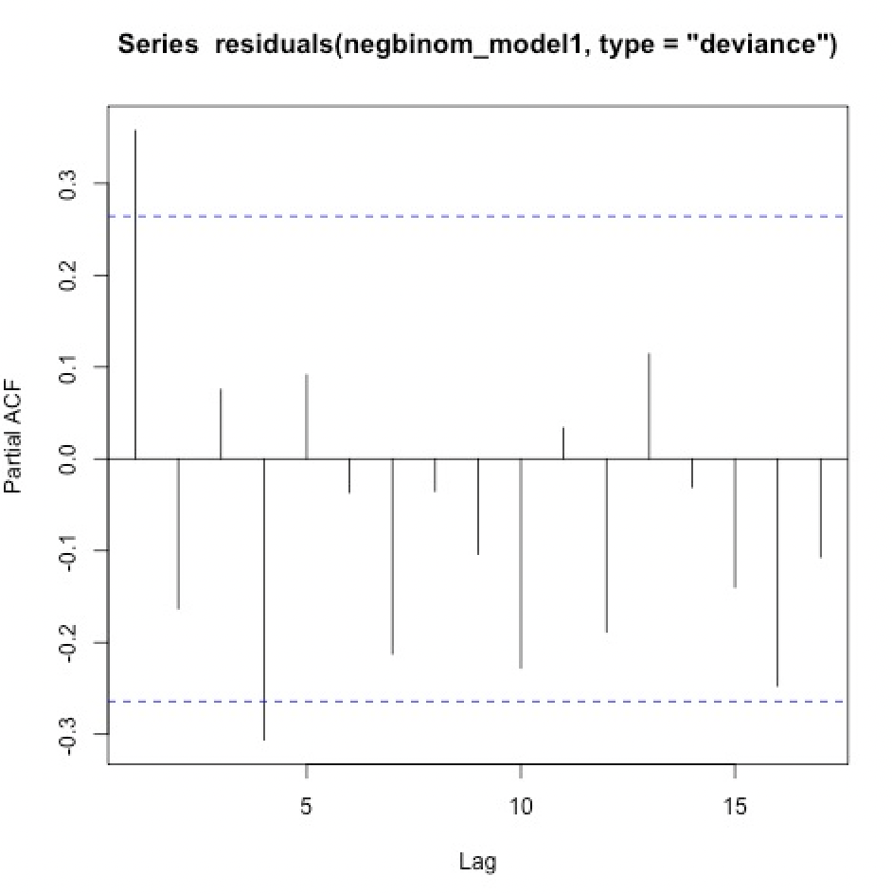
Dealing with Seasonality and Autocorrelation
Add the calendar month as a variable in the regression.
Produce partial autocorrelation plots. If there are spikes outside the threshold, add the lagged residuals to the model to adjust for them.

Slide 18
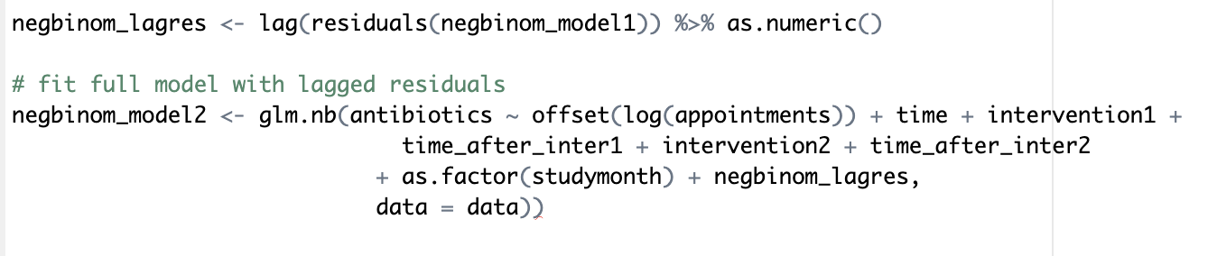
As the model is a negative binomial model, you must exponentiate the estimates from the model as you would for the Poisson.
These estimates are ratios (in this case, incidence rate ratios).
 | exp(Est.) | 2.50% | 97.50%
(Intercept) | 0.1215725 | 0.11315858 | 0.13061205
time | 0.99626676 | 0.99333394 | 0.99920824
intervention1 | 1.14397119 | 1.06660899 | 1.226944543
time_after_inter1 | 0.97769659 | 0.97143783 | 0.983995677
intervention2 | 1.21476911 | 1.11126427 | 1.327914543
time_after_inter2 | 1.02969338 | 1.01956218 | 1.039925241

Slide 19
Need two sets of predictions, one for the current observed data and one with the interventions and time since intervention variables set to 0.

Slide 20
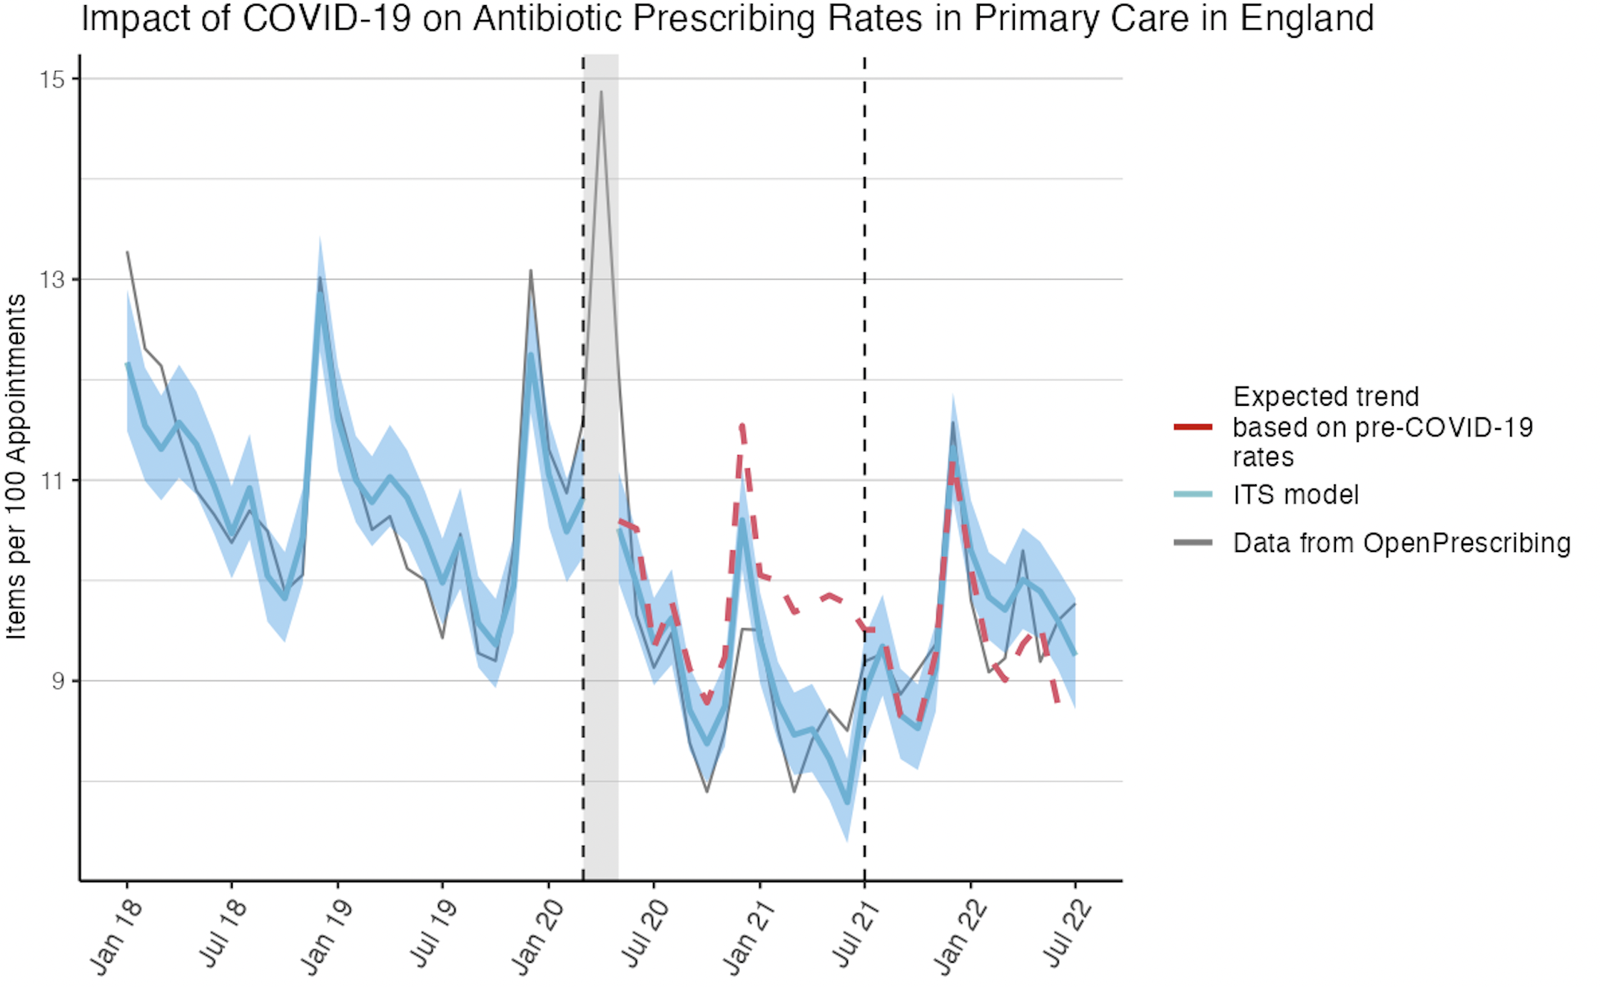
Sensitivity Analyses
Vary the dates of the intervention.
Introducing a “lag”.

Slide 21
References
Lopez Bernal J, Cummins S, Gasparrini A. Interrupted time series regression for the evaluation of public health interventions: a tutorial. International Journal of Epidemiology. 2016 Jun 9;46(1):dyw098.
Wagner AK, Soumerai SB, Zhang F, Ross-Degnan D. Segmented regression analysis of interrupted time series studies in medication use research. Journal of Clinical Pharmacy and Therapeutics. 2002 Aug;27(4):299–309.
Fusi F, Lecy J. Interrupted Time Series [Internet]. ds4ps.org. 2020. Available from: https://ds4ps.org/pe4ps-textbook/docs/p-020-time-series.html
Code for ITS available in SAS and R at: https://github.com/OliviaKBryant/antibiotic_prescribing_covid_ITS

